Slide 1
Department of CSE
COURSE NAME: Data science
COURSE CODE: 24AD3107
Topic:
Line Plot , Barchart and Scatter plot using Pyhton Matplotlib
Session - 4

Slide 2
AIM OF THE SESSION
To familiarize students with the basic concept of plotting like Line, Bar, Scatter plots using Matplotlib in Python.
INSTRUCTIONAL OBJECTIVES
This Session is designed to: Introduction to different plots line , bar, Scatter using Matplotlib in Python.
LEARNING OUTCOMES
At the end of this session, you should be able to: plot Line Bar and Scatter plots using Maatplotlib

Slide 3
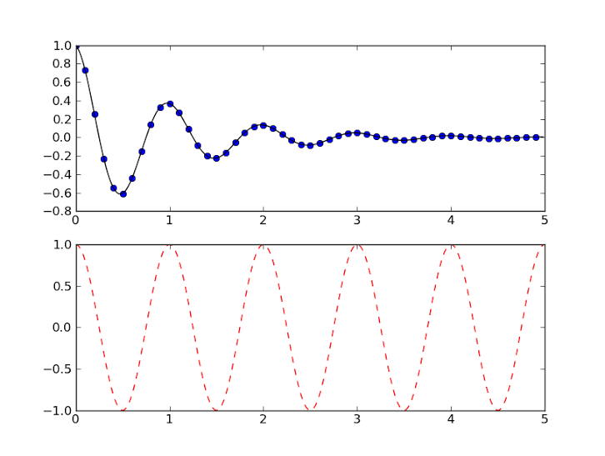
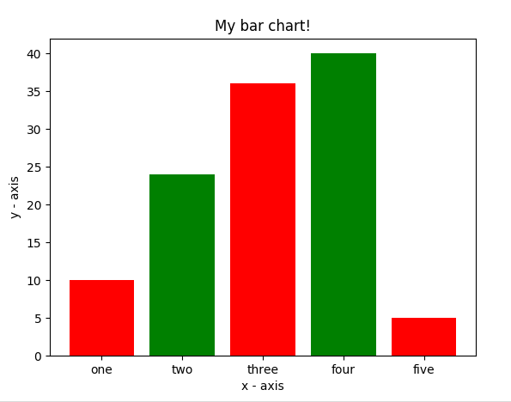
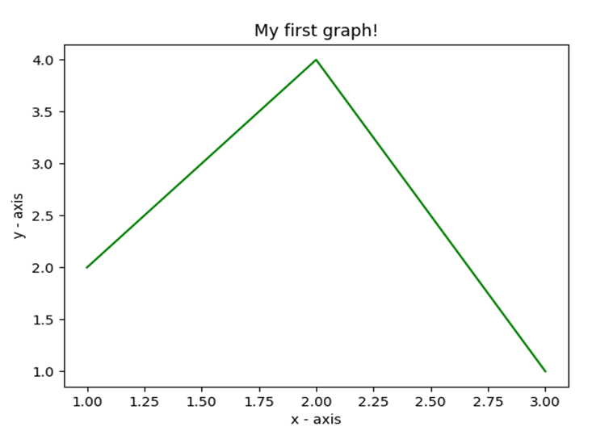
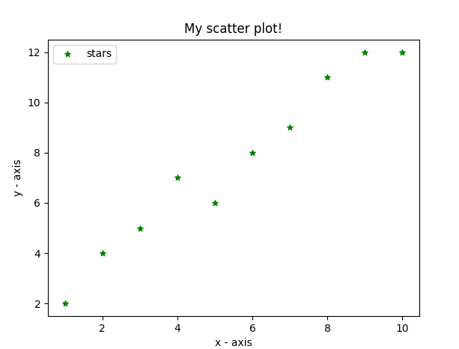
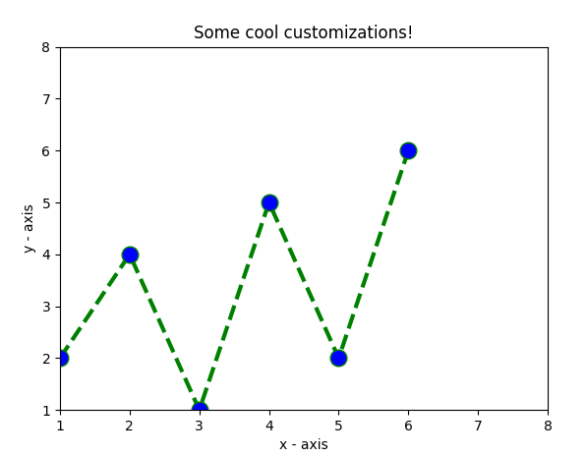
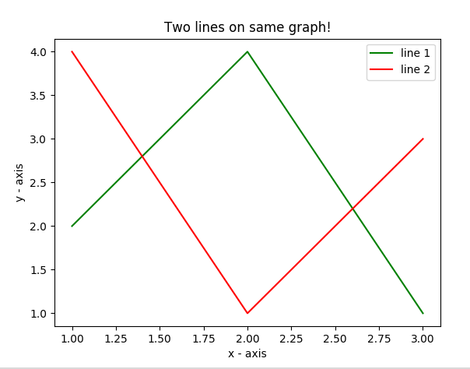
Matplotlib
Matplotlib allows you to make easy things
You can generate line plots, bar charts, scatterplots, etc., with just a few lines of code.

Slide 4
What is Data Visualization?
Data visualization is the practice of translating data into visual contexts, such as a map or graph, to make data easier for the human brain to understand and to draw comprehension from. The main goal of data viewing is to make it easier to identify patterns, styles, and vendors in large data sets.
Data visualization tools provide a way to present these figures and graphs.
Often, it is essential to analyze massive amounts of information and make data-driven decisions.
  converting complex data into an easy to understand representation

Slide 5
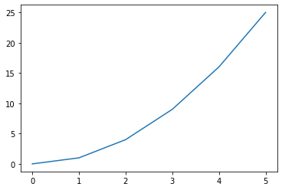
A line graph is a type of chart used to display information that changes over time or to show the relationship between two variables. It’s one of the simplest and most widely used visualization tools in statistics, science, and everyday data analysis.
Axes:the x-axis (horizontal) usually represents time or categories.
The y-axis (vertical) represents the values being measured.
Data points: each value is plotted as a point on the graph.
Lines: points are connected with straight lines to show trends or patterns.
Multiple lines: you can plot more than one dataset on the same graph to compare them.
import matplotlib.pyplot as plt
#create data for plotting
x_values = [0, 1, 2, 3, 4, 5 ]
y_values = [0, 1, 4, 9, 16,25]
#the default graph style for plot is a line
plt.plot(x_values, y_values)
#display the graph
plt.show()

Slide 6
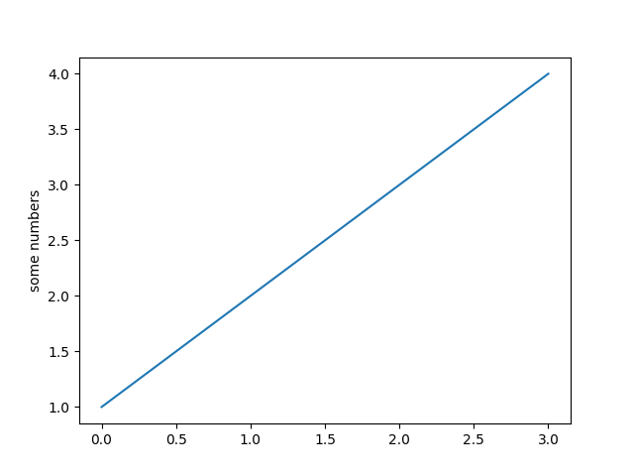
More on Line Graph
Note: if you provide a single list or array to the plot() command,
  then matplotlib assumes it is a sequence of y values, and
  automatically generates the
  x values for you.
Since python ranges start with 0,
the default x vector has the same length as y but starts with 0.
  Hence the x data are[0, 1, 2, 3].
import matplotlib.pyplot as plt
plt.plot([1, 2, 3, 4])
plt.ylabel('some numbers')
plt.show()

Slide 7
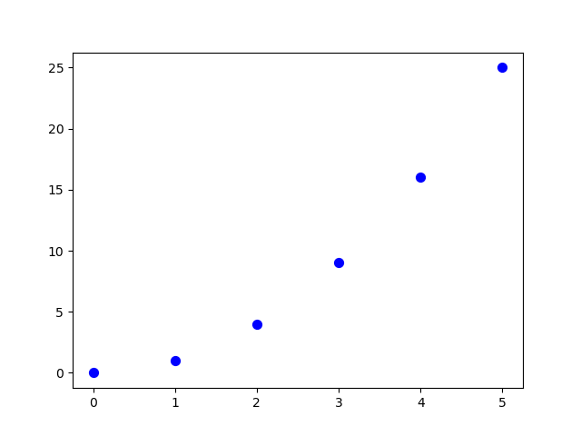
Scatter Plots
import matplotlib.pyplot as plt
#create data for plotting
x_values = [0,1,2,3,4,5]
y_values = [0,1,4,9,16,25]
plt.scatter(x_values, y_values, s=30, color=“blue")
plt.show()

Slide 8
Scatter plot
import matplotlib.pyplot as plt
# x-axis values
x = [1,2,3,4,5,6,7,8,9,10]
# y-axis values
y = [2,4,5,7,6,8,9,11,12,12]
# plotting points as a scatter plot
plt.scatter(x, y, label= "stars", color="green", marker="*", s=30)
# x-axis label
plt.xlabel('x - axis')
# frequency label
plt.ylabel('y - axis')
# plot title
plt.title('My scatter plot!')
# showing legend
plt.legend()
# function to show the plot
plt.show()

Slide 9
Scatter plot
The scatter plots are mostly used for comparing variables when we need to define how much one variable is affected by another variable. The data is displayed as a collection of points. Each point has the value of one variable, which defines the position on the horizontal axes, and the value of other variable represents the position on the vertical axis.
Syntax:
matplotlib.pyplot.scatter(x_axis_data, y_axis_data, s=None, c=None, marker=None, cmap=None, vmin=None, vmax=None, alpha=None, linewidths=None, edgecolors=None)
x_axis_data- An array containing x-axis data
y_axis_data- An array containing y-axis data
s- marker size (can be scalar or array of size equal to size of x or y)
c- color of sequence of colors for markers

Slide 10
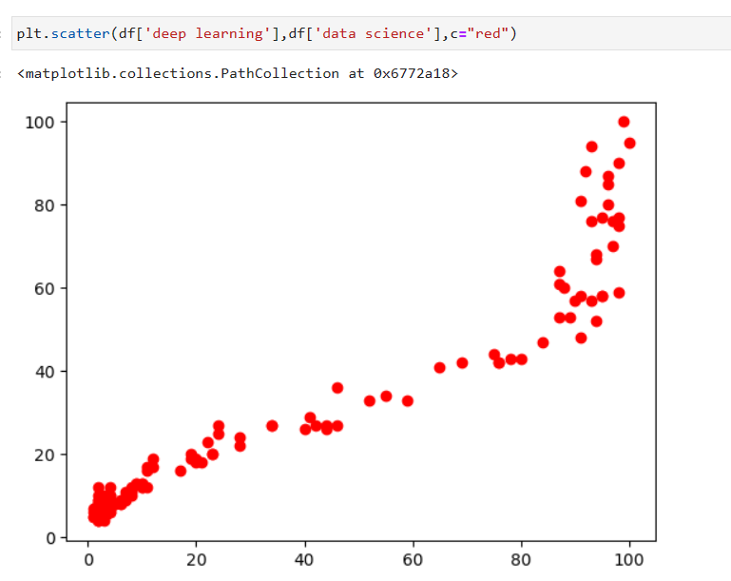
  marker- marker style
cmap- cmap name
linewidths- width of marker border
edgecolor- marker border color
alpha- blending value, between 0 (transparent) and 1 (opaque)
Except x_axis_data and y_axis_data all other parameters are optional and their default value is None.

Slide 11
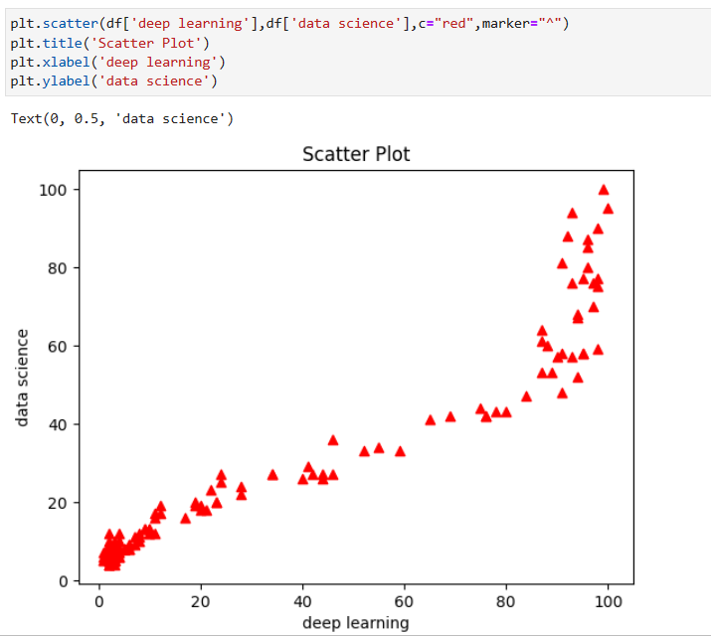

Slide 12
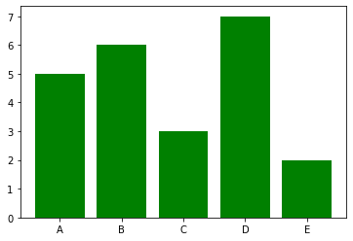
Bar graphs
import matplotlib.pyplot as plt
#Create data for plotting
values = [5, 6, 3, 7, 2]
names = ["A", "B", "C", "D", "E"]
plt.bar(names, values, color="green")
plt.show()
When using a bar graph, the change in code will be from
plt.plot() to plt.bar() changes it into a bar chart.

Slide 13
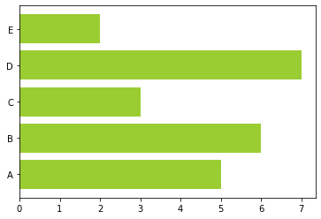
Bar graphs
We can also flip the bar graph horizontally with the following
import matplotlib.pyplot as plt
#Create data for plotting
values = [5,6,3,7,2]
names = ["A", "B", "C", "D", "E"]
# Adding an "h" after bar will flip the graph
plt.barh(names, values, color="yellowgreen")
plt.show()

Slide 14
Bar Chart
import matplotlib.pyplot as plt
# heights of bars
height = [10, 24, 36, 40, 5]
# labels for bars
names = ['one','two','three','four','five']
# plotting a bar chart
c1 =['red', 'green']
c2 =['b', 'g'] # we can use this for color
plt.bar(left, height, width=0.8, color=c1)
# naming the x-axis
plt.xlabel('x - axis')
# naming the y-axis
plt.ylabel('y - axis')
# plot title
plt.title('My bar chart!')
# function to show the plot
plt.show()
Here, we use plt.bar() function to plot a bar chart.
you can also give some name to x-axis coordinates by defining tick_labels

Slide 15
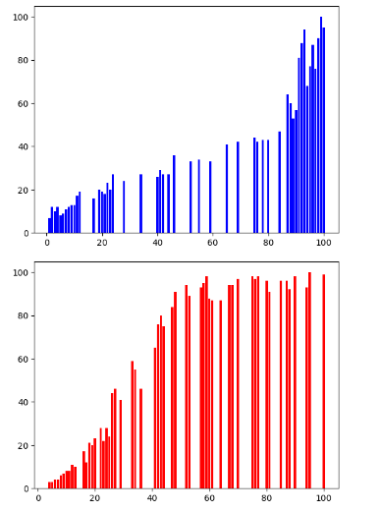

Bar Plot:
Bar graphs are one of the most common types of graphs and are used to show data associated with the categorical variables. Matplotlib provides a bar() to make bar graphs which accepts arguments such as: categorical variables, their value and color.

Slide 16
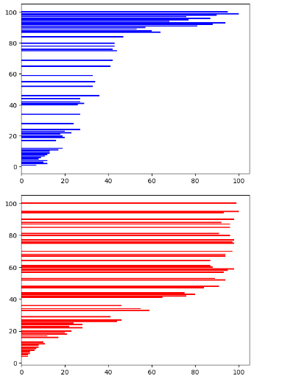
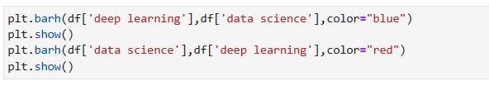
Another function barh() is used to make horizontal bar graphs. It accepts xerr or yerr as arguments (in case of vertical graphs) to depict the variance in our data as follows:

Slide 17
REFERENCES FOR FURTHER LEARNING OF THE SESSION
Text Books:
Introduction to Data Science- A Structured Methodology,Goran trajkovski.
Data Science from Scratch- Joel Grus - O’Reilly - 2015
Practical Statistics for Data Scientists - Peter Bruce, Andrew Bruce & Peter Gedeck - O’Reilly - 2020
Data Science and Machine Learning (Mathematical and Statistical Methods) - Dirk P. Kroese, Zdravko I. Botev, Thomas Taimre, Radislav Vaisman- Chapman and Hall/CRC - 2025
Foundations of Data Science - Avrim Blum, John Hopcroft, and Ravindran Kannan - Cambridge University Press – 2020
Reference Books:
R1.Data Science and Its Applications by Aakanksha Sharaff and G. R. Sinha.
R2. Introducing Data Science Big Data, Machine Learning, and more using Python tools. by Davy cielen, Arno D.B. Meysman and Mohamed Ali.

Slide 18

THANK YOU
Team – DS

